Slide 1

Chief Tech Rubber Industrial Co., Ltd.
Company Profile

Slide 2
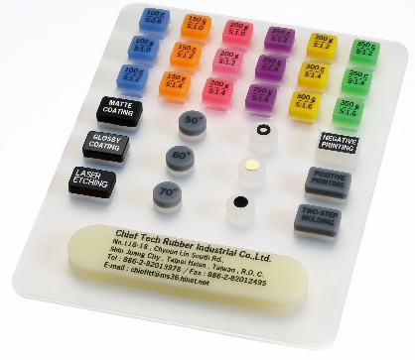
Who We Are:
Chief Tech Rubber Industrial Co., Ltd. was founded in 1990, has been committed to customer satisfaction and providing quality services and become the industrial leader.
For the past 30 years, Chief Tech Rubber had been manufacturing, and supplying a wide range of silicone rubber products for almost any demands. We specialize in varies types and forms of Keypads, oil seal, waterproof ring, O-ring, rubber-to-metal bonding, rubber-to-plastic bonding and so on.
Our Mission & Vision
We insist always improve as we continue to change and grow in order to fulfill our global customers.
Chief Tech Rubber had moved to current new plant in 2019. To continue its expansion by adding new personnel, equipment and facilities to better serve the technical needs of our growing list of customers.

Slide 3
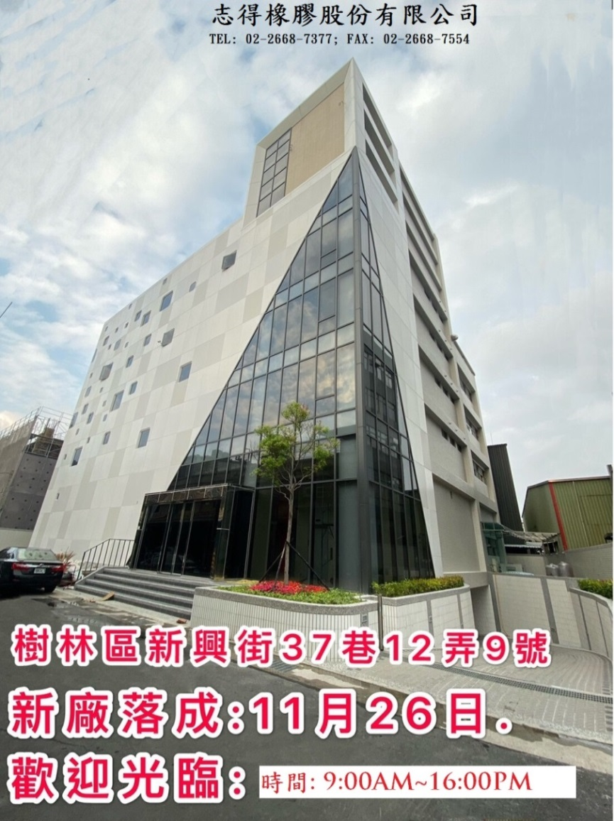
Company Brief:
Established: Since 1990
Location: Taiwan, R.O.C. (only)
Employee: 80
Floor Area: 29,062.6 Square Feet
Rubber Product Manufacturing
Rubber with Various material
Product Manufacturing
Certificates: ISO 9001: 2015
ISO 13485: 2016
RoHs / Reach/ ASTM are available

Slide 4
Company turnover:
Sales Revenue: US$3,420,000 ~3,240,000 (Average)
Mainly Customers:
domestic market demand: 65%;
others demand: 35% including
US (15%); Euro (10%); Mainland China (5%); Asia (5%)
Focus Industries:
Electronics (40%) - especially Computer & Consumer electronics
Industries (40%) - especially Automotive
Medical (5%) – especially Class I & Class II Devices
Others (15%) – Military, Nautical industry, and so on.

Slide 5

Our Products Application fields:
Various Industries
Automotive
Military
Medical
Computer & Consumer Electronics
Telecommunications
Nautical
Industries

Slide 6
Organization::
President
General Manager
Tooling section
Financial section
Production planning section
Property overall planning
Manufacturing Dept.
Mixer section
Human Resource section
Domestic Sales
Forming section
Compression Molding section
Sales Dept.
International Sales
Purchasing section
Warehouse management section
Quality Management Dept.
QA
QC
Engineering Dept.
Technical section
Management
Dept.
Injection
section
Deburring section
Chart:

Slide 7
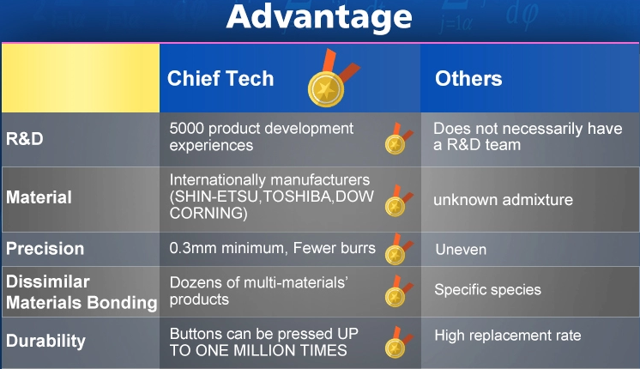
Comparing to Others:

Slide 8
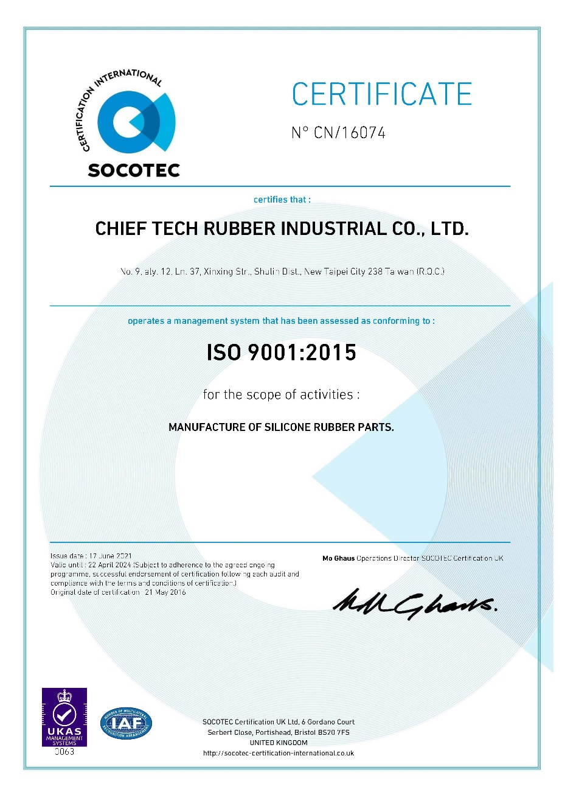
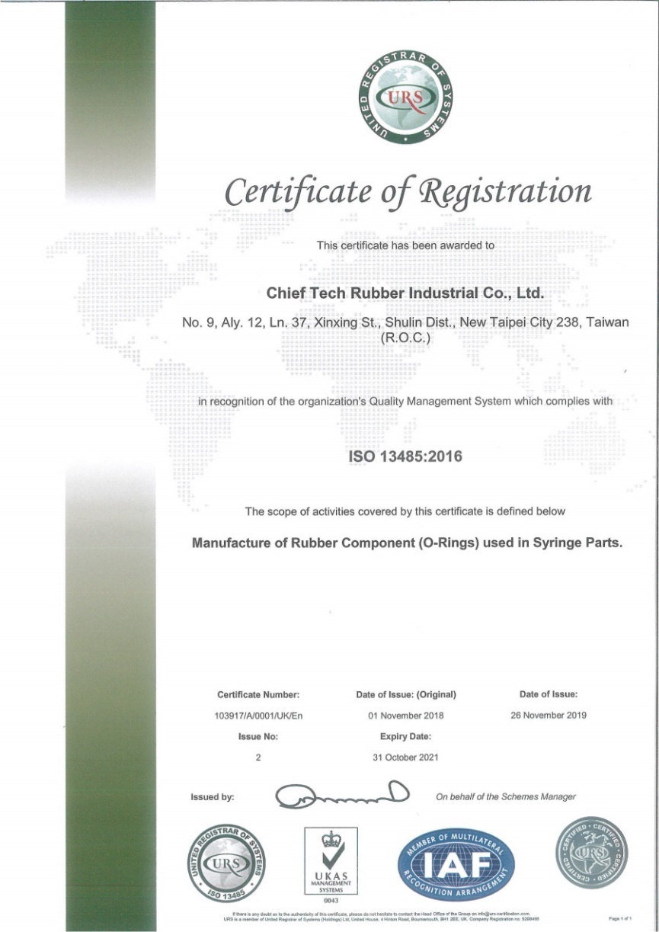
ISO Certification:
ISO 9001: 2015 & ISO 13485: 2016

Slide 9
Our value in various application

Slide 10
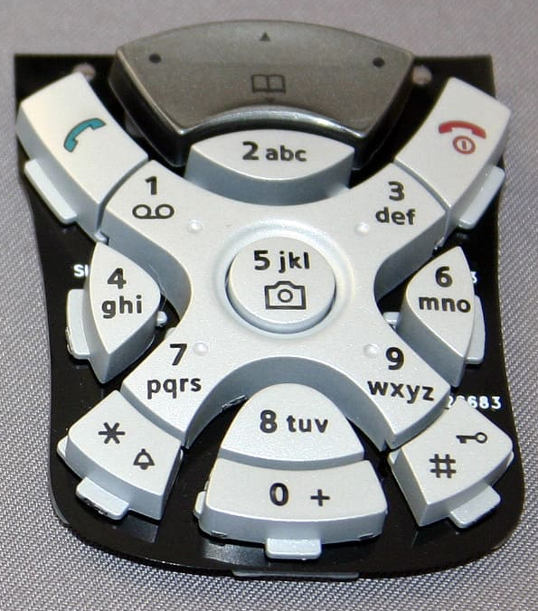
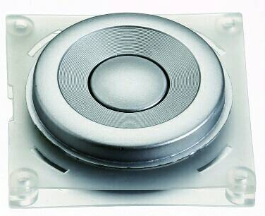
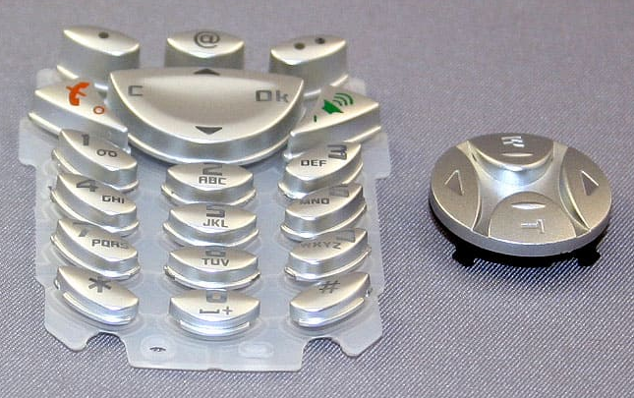
Product Applications
Telecommunications:
Various Keypads
Smartphone Cover Seal
Waterproof Seal
And so on.

Slide 11
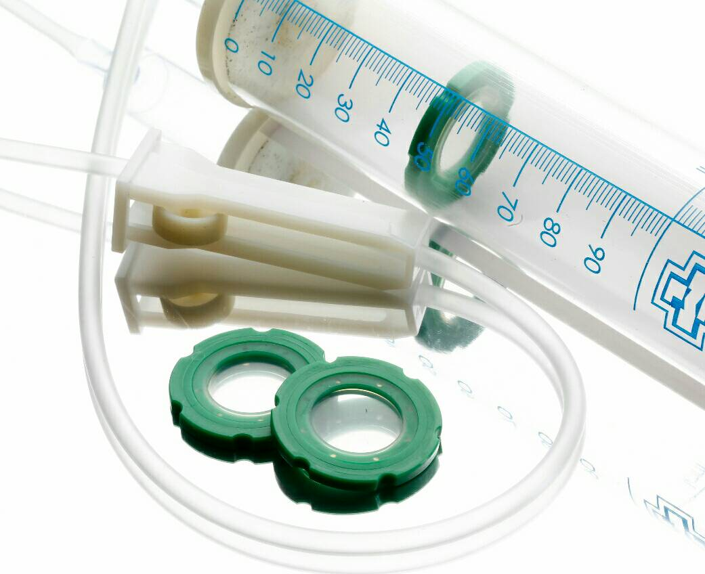
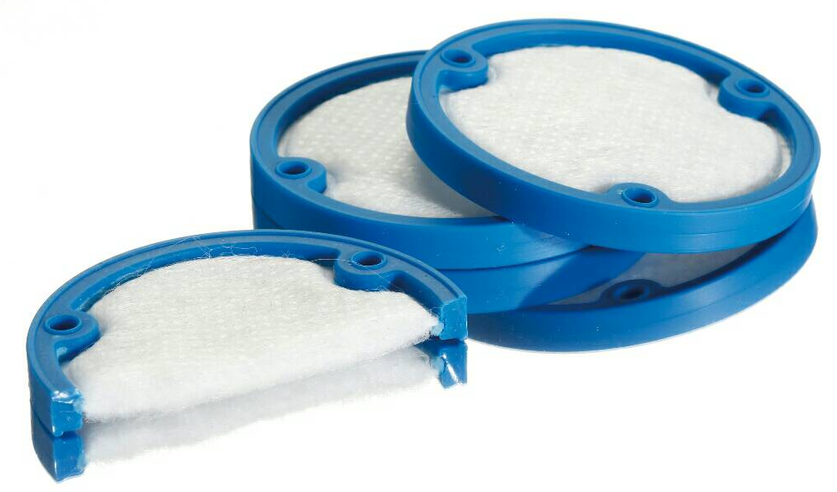
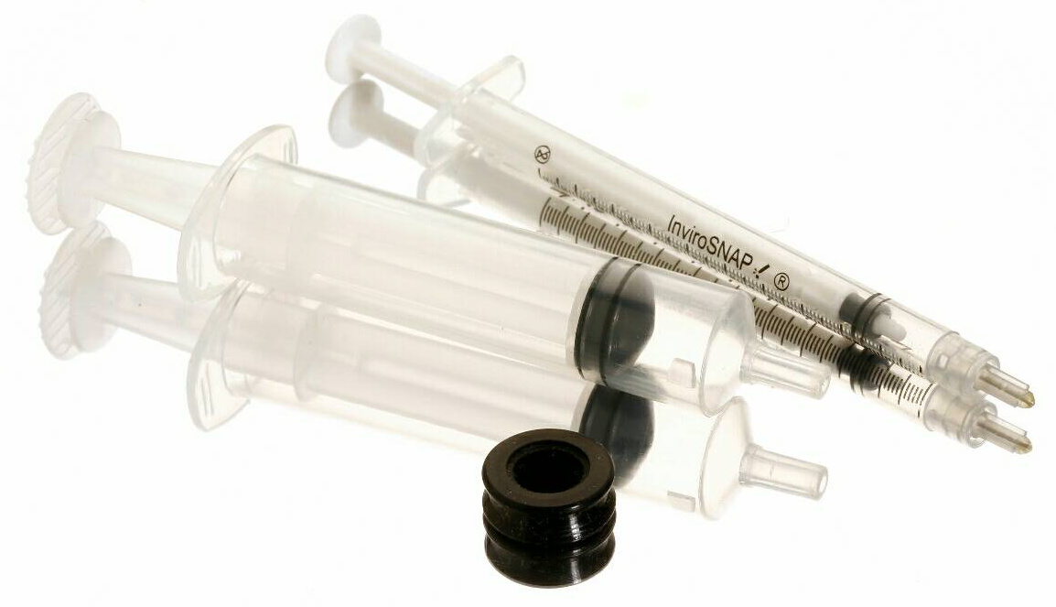
Product Applications
Medical:
Various O-rings
Waterproof Seal
Silicone drip tip stopper
Rubber to plastic bonding
Rubber to fabric bonding

Slide 12
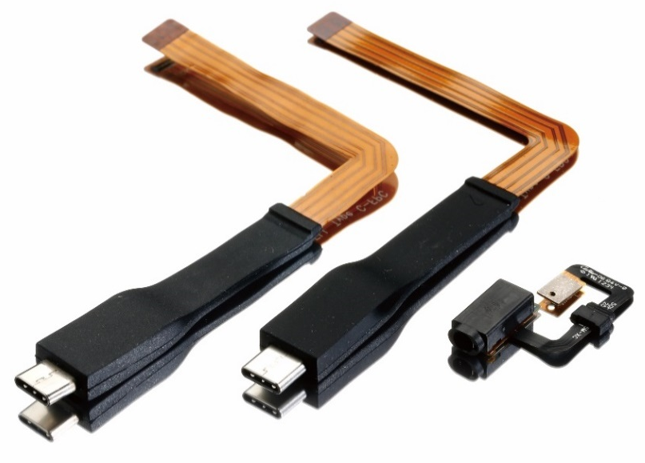
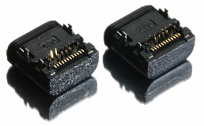
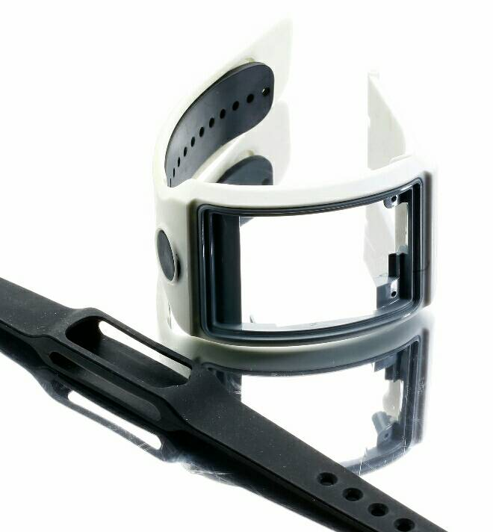
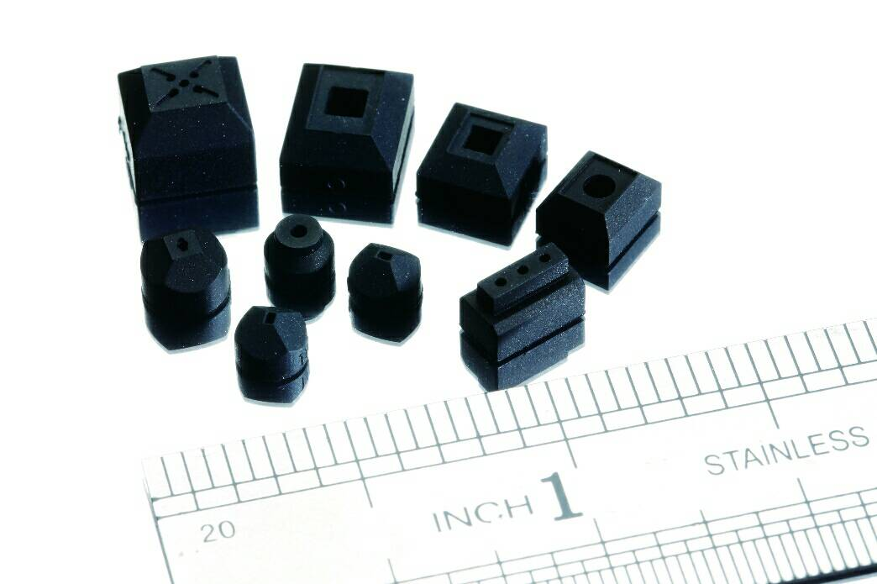
Product Applications:
Computer & Consumer Electronics:
Various O-rings
Waterproof products in Silicone Rubber
Rubber to plastic bonding
Rubber to metal bonding
Rubber to FPC bonding

Slide 13
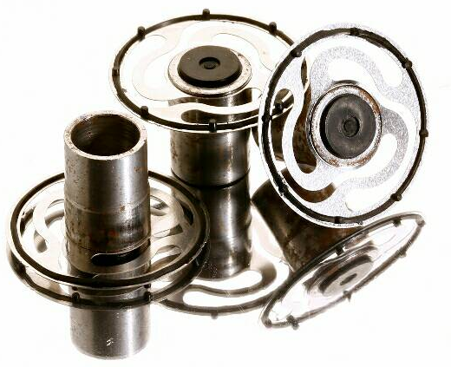
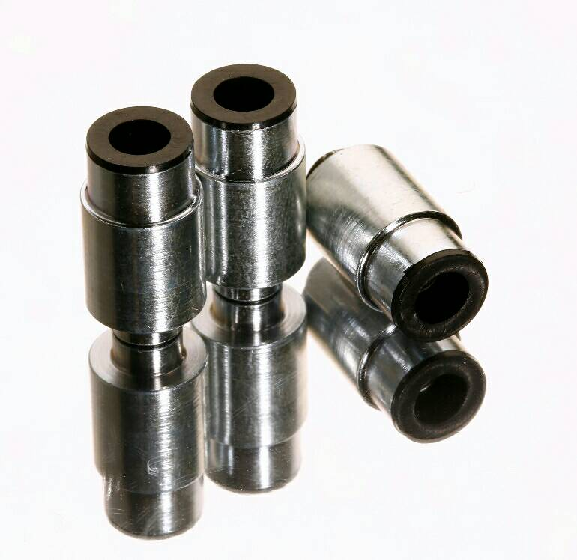
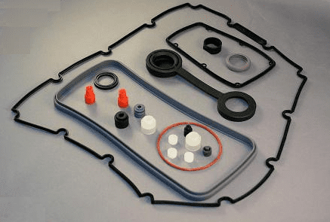
Product Applications:
Industries:
Various O-rings
Waterproof Seals
Rubber to plastic bonding
Rubber to metal bonding
And so on

Slide 14
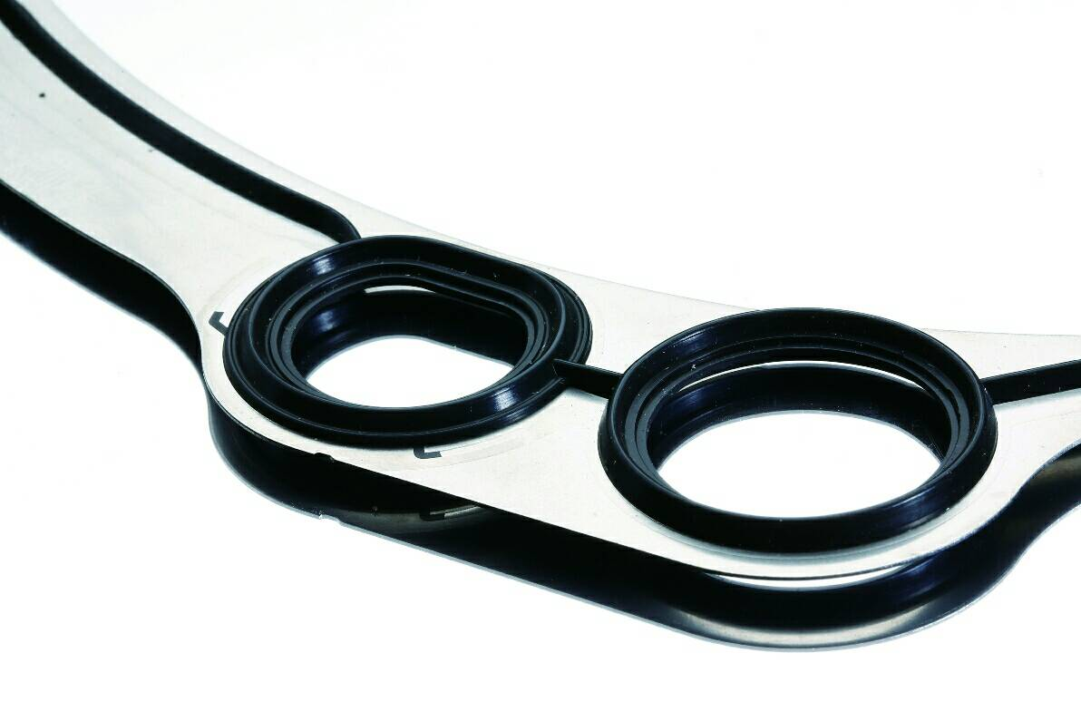
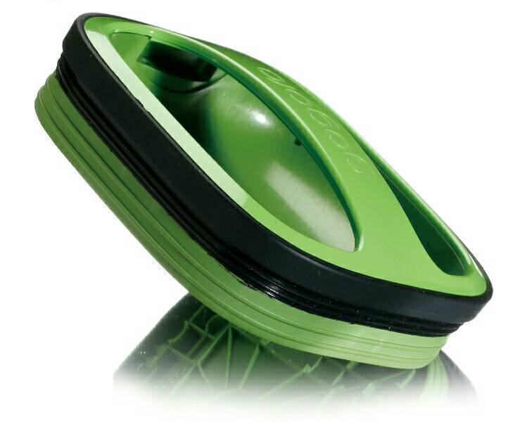
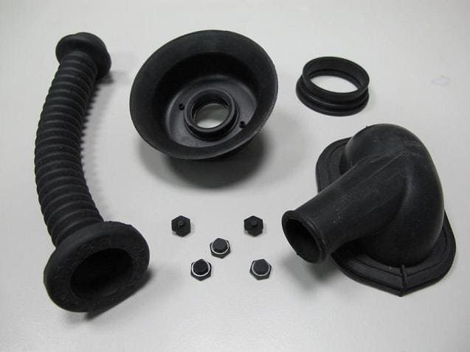
Product Applications:
Automotive:
Various O-rings
Waterproof Seals
Rubber to plastic bonding
Rubber to metal bonding
And so on

Slide 15
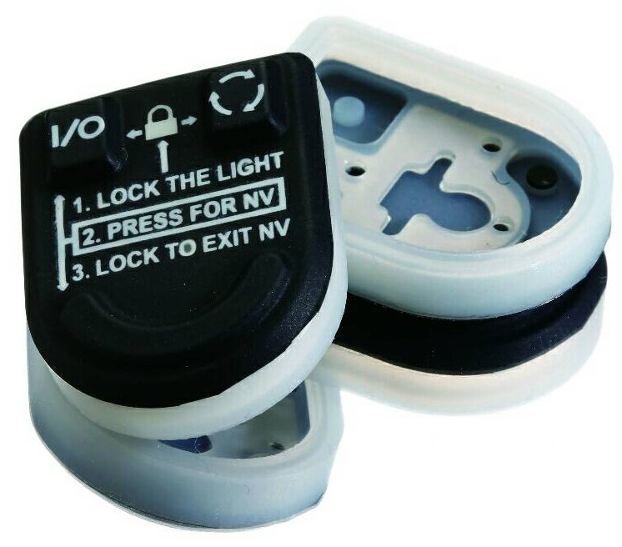
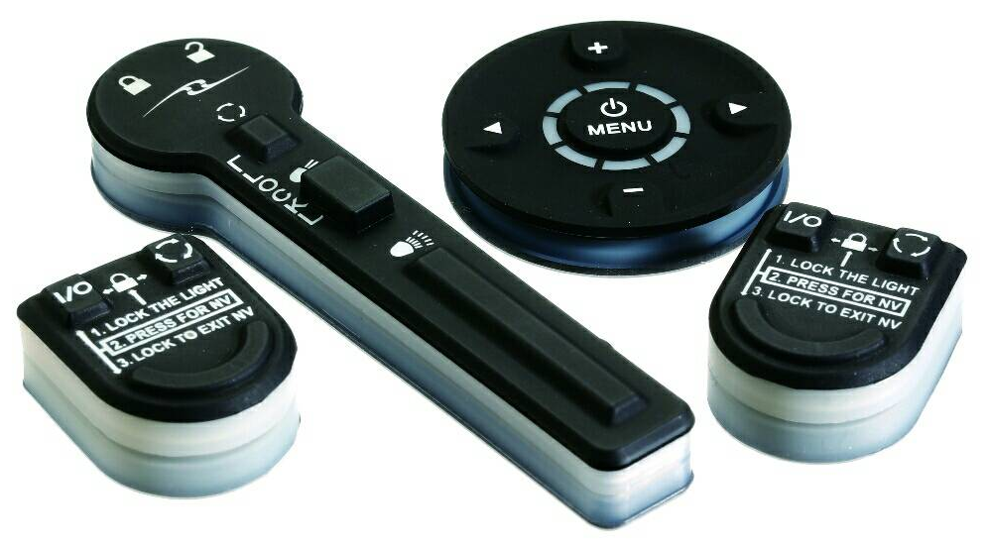
Product Applications:
Military:
Waterproof Cover
Rubber to plastic bonding
Rubber to metal bonding
And so on

Slide 16
Our value in technician & production
How we do it:
Heat Compression
Rubber Injection
Liquid Silicone injection molding
Transferring molding
Over molding and so on.

Slide 17
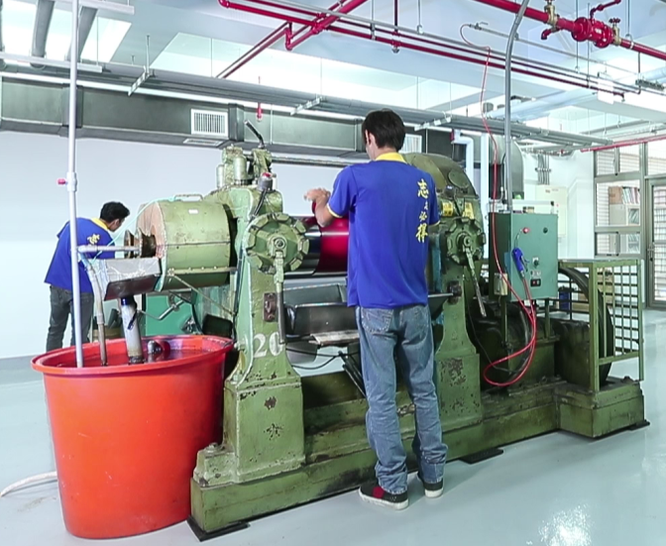
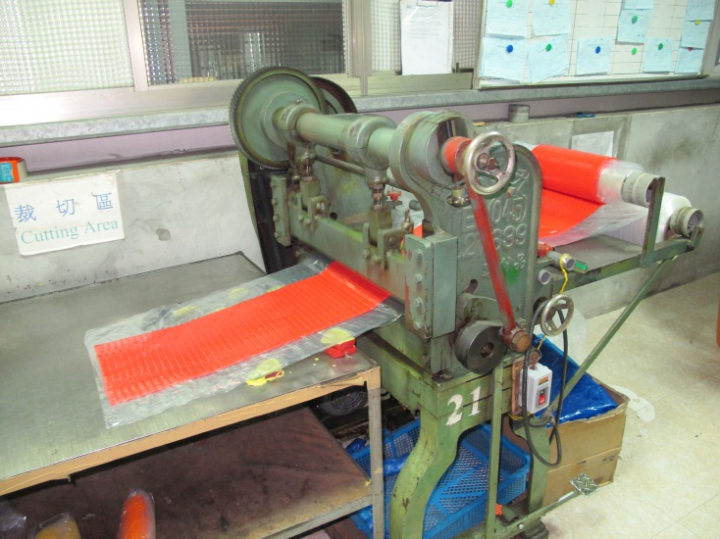
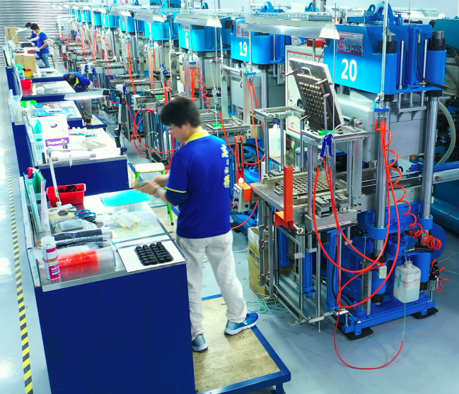
What we have - Production Equipment:
Mixer Machine
Cutting Machine
Heat Compression Machine

Slide 18
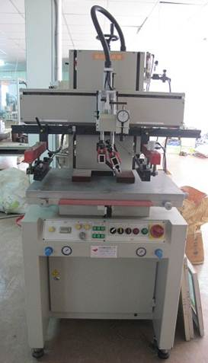
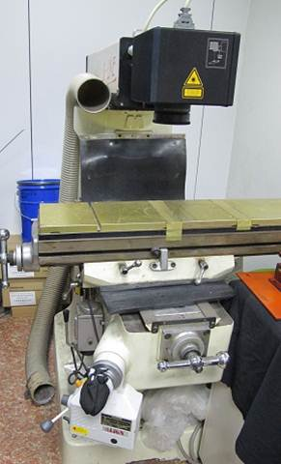
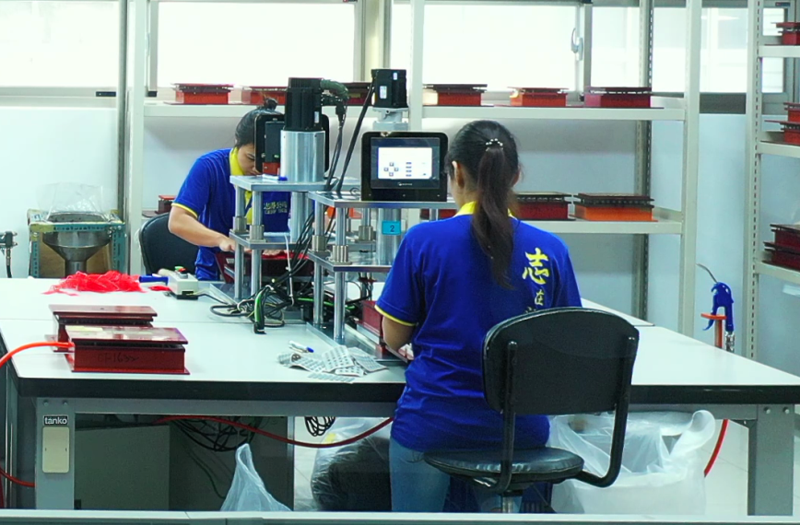
Production Equipment:
Auto-Rubber Deflashing Machine
Laser Engraving Machine
Screen Printer

Slide 19
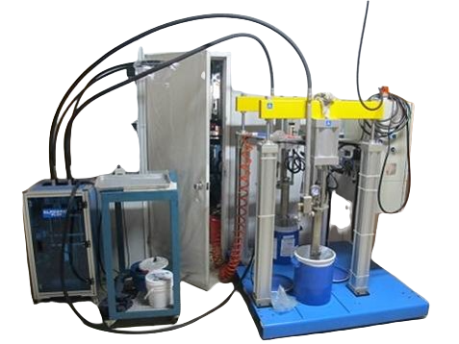
Production Equipment:
Liquid Silicone Rubber Meter Mixing Machine

Slide 20
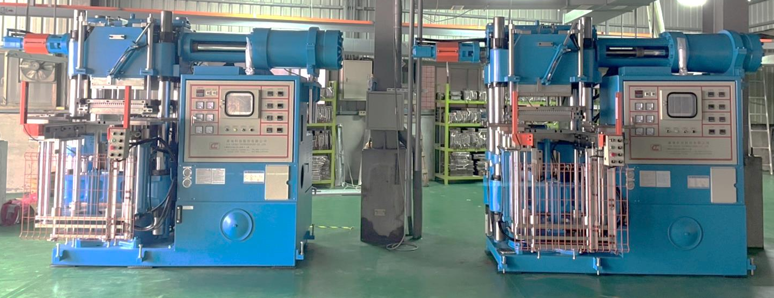
Production Equipment:
Rubber Injection Machine

Slide 21
Our value in Quality Control
Internal Lab. With Cutting-Edge Inspection Equipment
InPut Process Quality Control (IPQC) per 3H
100% Inspection
And AQL system for Out-going Quality Control (OQC)

Slide 22
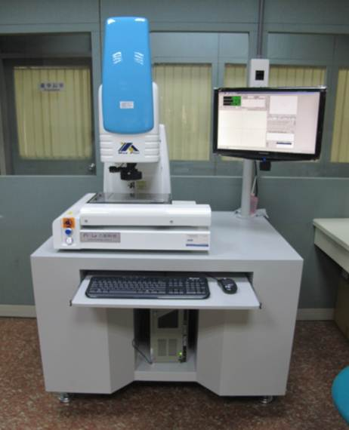
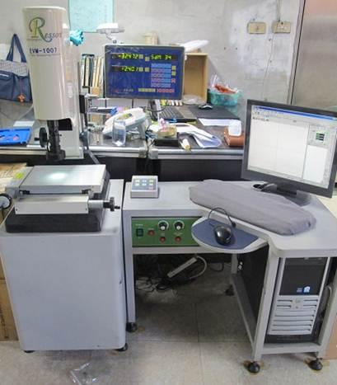
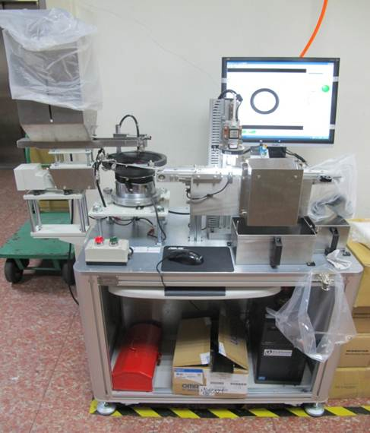
Inspection Instrument:
2.5D Image Measuring Instrument
2.5D Image Measuring Instrument
Auto-measuring Instrument

Slide 23
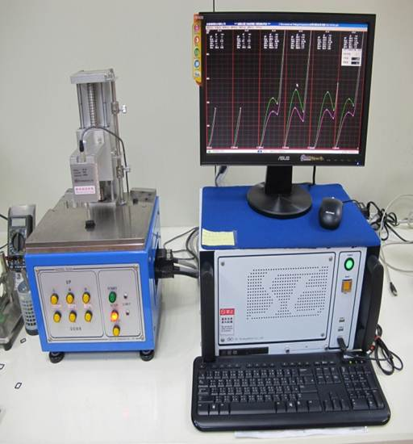
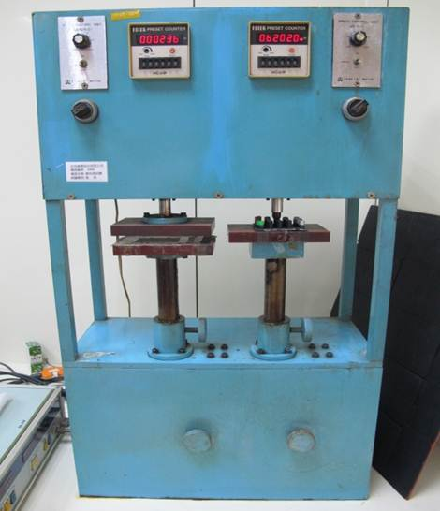
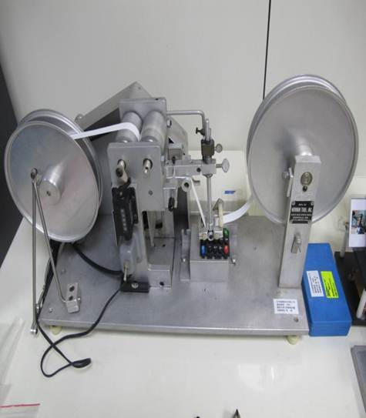
Inspection Instrument:
Desktop Force Tester (Switch feeling tester)
Fatigue Testing Machine
RCA Abrasion Wear Tester

Slide 24
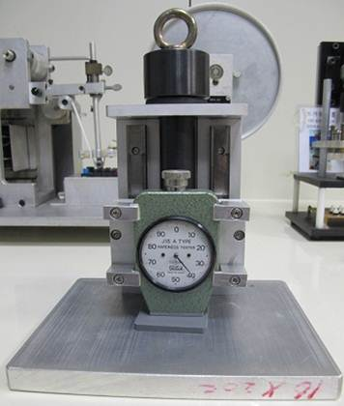
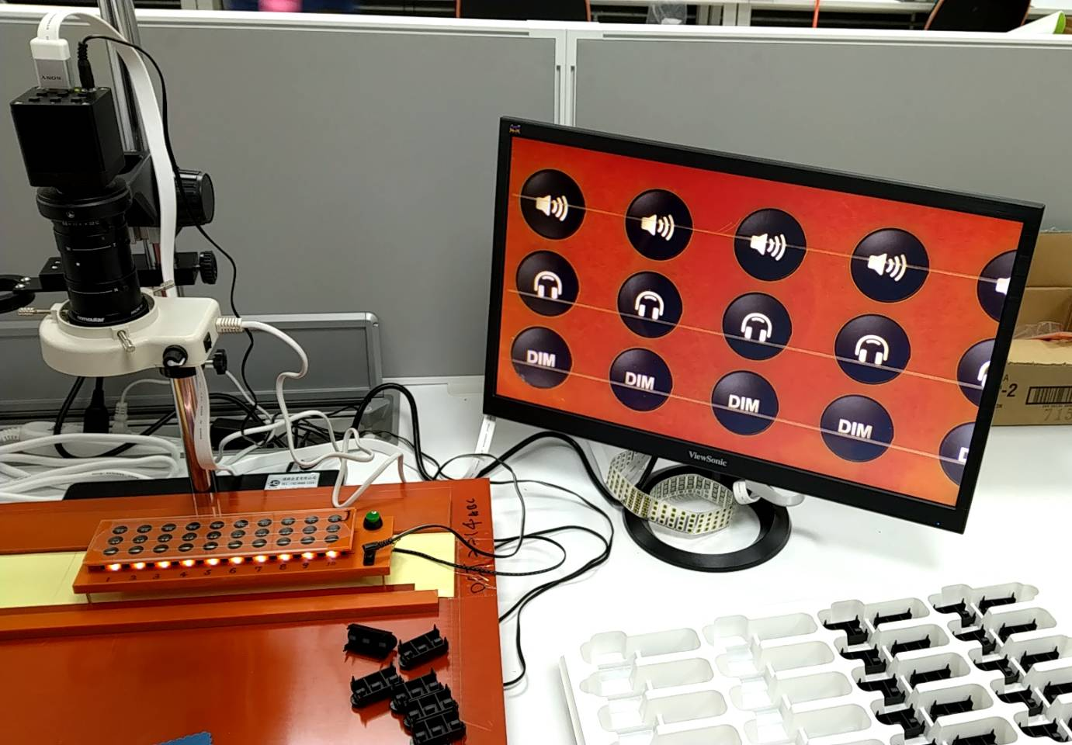
Inspection Instrument:
High Magnification Inspection
Hardness (1Kg)

Slide 25
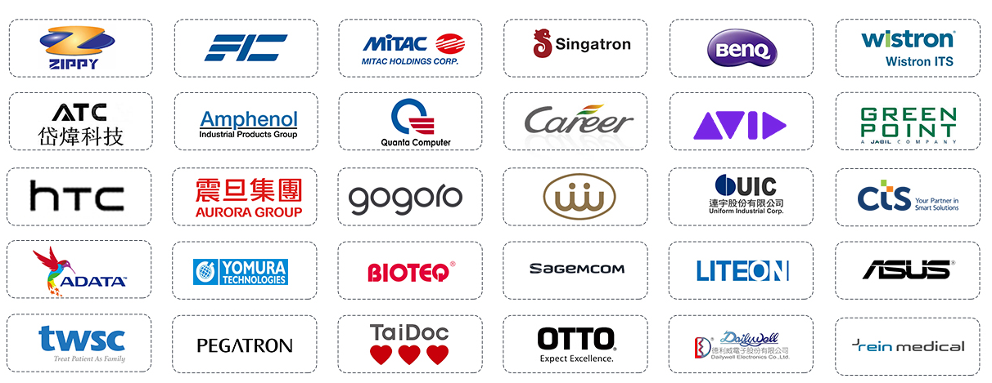




Our Partners:

Slide 26
contact us directly for further discussion.
Thank you~

