Slide 1
Chief Tech Rubber Industrial Co., Ltd.
Company Profile

Slide 2
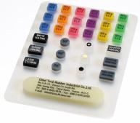
Who We Are:
Chief Tech Rubber Industrial Co., Ltd. was established in 1990, has been committed to customer satisfaction and providing quality services, and become the industrial leader.
For the past 30 years, Chief Tech Rubber has been manufacturing and supplying a wide range of silicone rubber products for almost any demand. We specialize in manufacturing various types and forms of Keypads, oil seals, waterproof O-rings, gaskets, rubber to metal over molding, rubber to plastic over molding, and so on.
Our Mission & Vision
We insist on always improving as we continue to change and grow in order to fulfill our global customers.
Chief Tech Rubber has been moved to the current plant since 2019. To continue its expansion by adding new personnel, equipment, and facilities to better serve the technical needs of our growing list of customers.

Slide 3
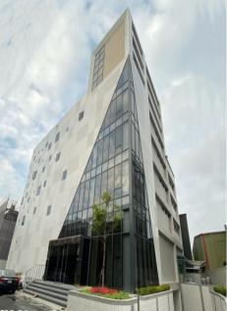
COMPANY brief:
Established: Since 1990
Headquarter: New Taipei City, Taiwan
Employee: 80
Manufacturing Site: Taiwan/ New Taipei City
Main Products: Custom- Rubber / Silicone products
Quality System: ISO 9001: 2015
ISO 13485: 2016
Certificates: RoHs /Reach/UL and so on.

Slide 4
Company turnover:
Sales Revenue 2021: USD 3.3 million
Sales Revenue 2022: USD 3.95 million
Mainly Customers:
Domestic market demand: 65%;
International market demand: 35% including
US (15%); Euro (5%); Asia (10%); Others (5%)
Focus Industries:
Electronics (40%) - especially Computer & Consumer electronics.
Industries (40%) - especially Industrial Machinery.
Medical (5%) – especially Medical Devices.
Others (15%) – Telecommunication, Military, Semiconductor industry, LED, Passive component, Nautical industry, and so on.

Slide 5
Our Products Application fields:
Various Industries
Computer & Consumer electronics
Industries
Medical
Semiconductor
Telecommunications
LED
Automotive

Slide 6
Organization::
President
Management Team
In-House Tooling section
Financial section
Production planning section
Property overall planning
Manufacturing Dept.
Raw Material Cutting section
Human Resource section
Domestic Sales
Injection Molding Section
Compression Molding section
Sales Dept.
International Sales
Purchasing section
Warehouse management section
Quality Management Dept.
QA
QC
Engineering Dept.
Technical section
Administration
Dept.
Raw Material Mixer section
De-flashing section
Packing & Shipping
Chart:

Slide 7
Comparing to Others:

Slide 8
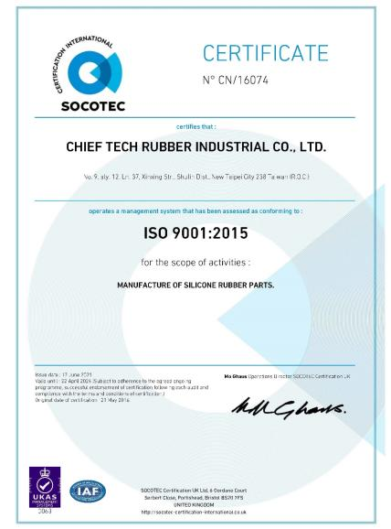
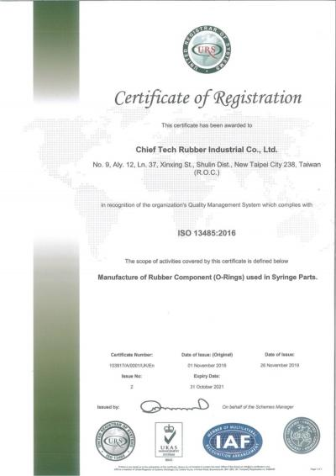
ISO Certification:
ISO 9001: 2015 & ISO 13485: 2016

Slide 9
Our value in various application

Slide 10
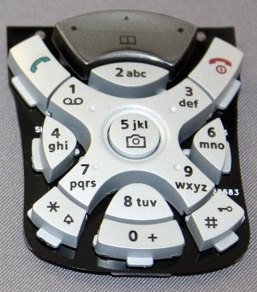
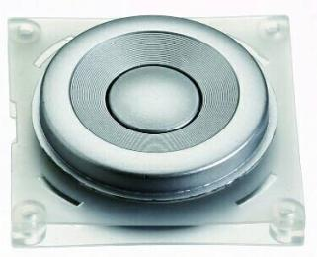
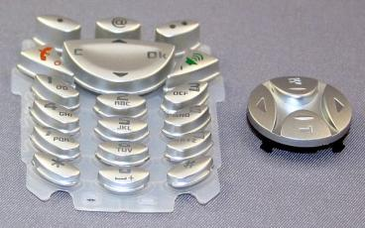
Product Applications
Telecommunications:
Various Keypads with membrane switch design
Smartphone Cover Seal
Waterproof Seal
And so on.

Slide 11
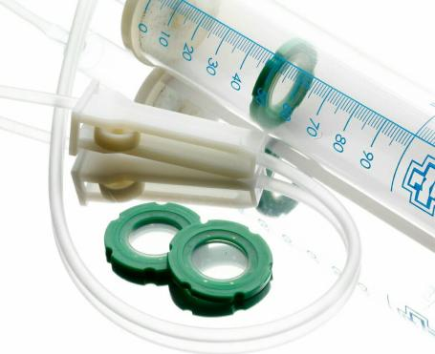
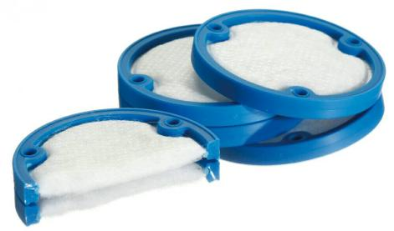
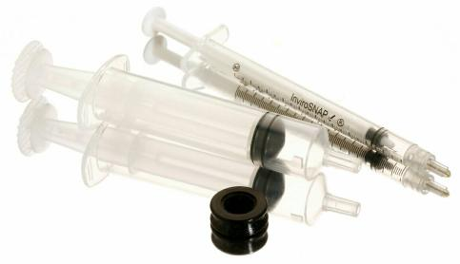
Product Applications
Medical:
Various O-rings
Waterproof Seal
Silicone drip tip stopper
Rubber to plastic bonding
Rubber with fabric over-molding

Slide 12
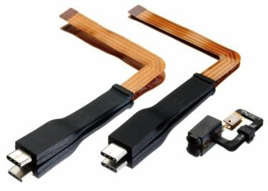
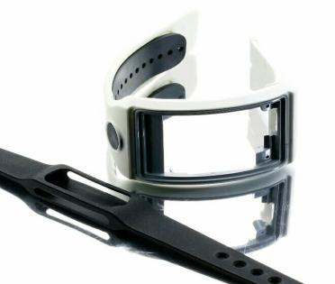
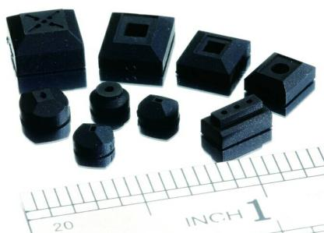
Product Applications:
Computer & Consumer Electronics:
Various O-rings
Waterproof products in Silicone Rubber
Rubber to plastic bonding
Rubber with metal over-molding
Rubber with FPC insert-molding

Slide 13
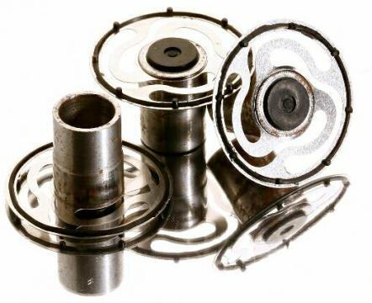
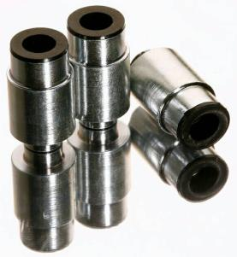
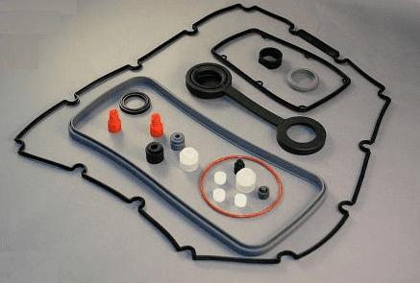
Product Applications:
Industries:
Various O-rings
Waterproof Seals
Rubber to plastic bonding
Rubber with metal over-molding
Rubber with metal insert-molding

Slide 14
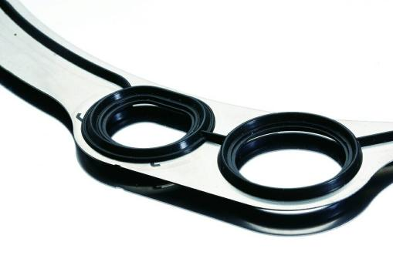
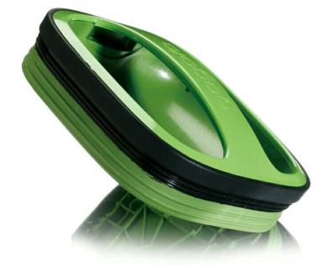
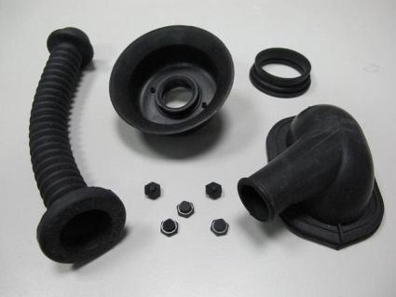
Product Applications:
Automotive:
Various O-rings
Waterproof Seals
Rubber to plastic bonding
Rubber with plastic insert molding
And so on

Slide 15
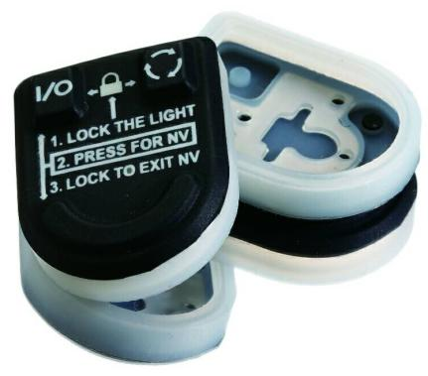
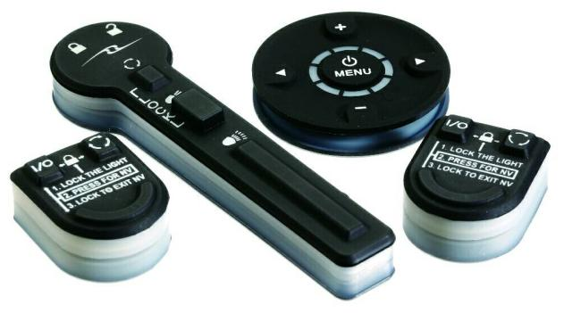
Product Applications:
Military:
Waterproof Cover
Rubber to plastic bonding
Rubber with metal instert-molding
And so on

Slide 16
Our value in technician & production
How we do it:
Silicone Rubber Compression Molding
Rubber Injection
Silicone injection
Silicone transferring molding
Silicone with different materials Over molding and so on.

Slide 17
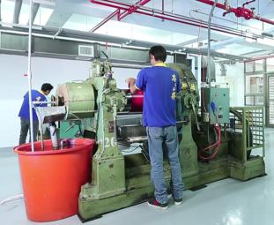
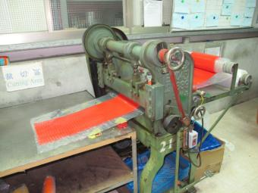
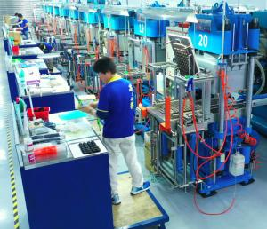
What we have - Production Equipment:
Mixer Machine
Cutting Machine
Compression Molding Machine

Slide 18
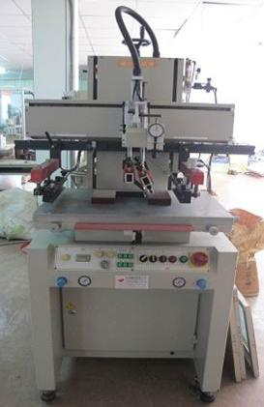
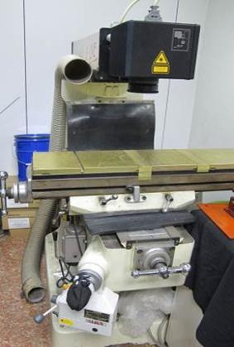
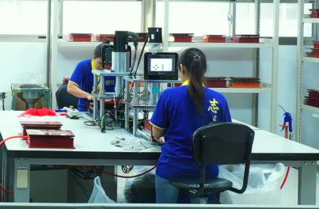
Production Equipment:
Auto-Rubber Deflashing Machine
Laser Engraving Machine
Screen Printer

Slide 19
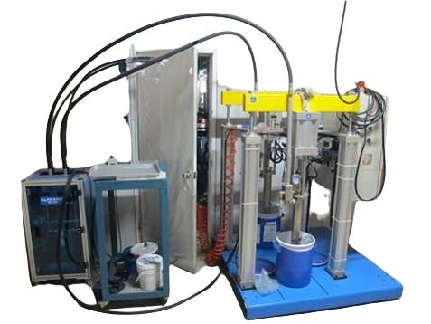
Production Equipment:
Liquid Silicone Rubber Meter Mixing Machine

Slide 20
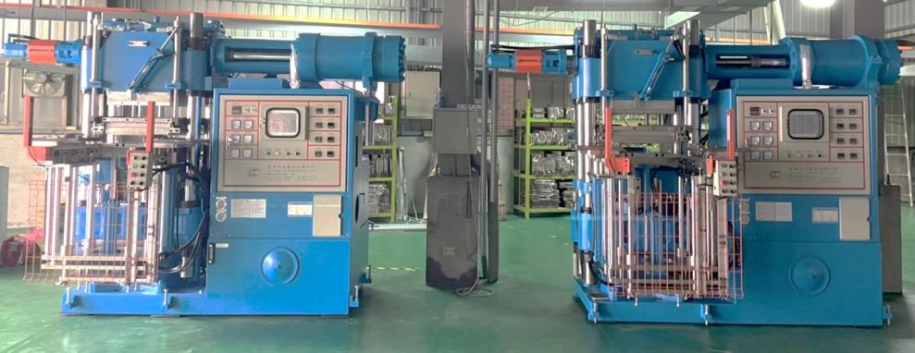
Production Equipment:
Rubber Injection Machine

Slide 21
Our value in Quality Control
Internal Lab. With Cutting-Edge Inspection Equipment
Input Process Quality Control (IPQC) per 3H
100% Inspection
And AQL system for Out-going Quality Control (OQC)

Slide 22
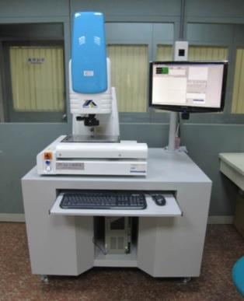
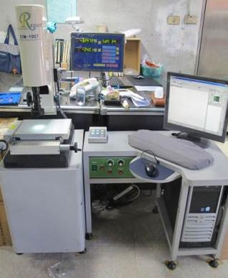
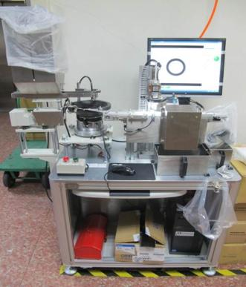
Inspection Instrument:
2.5D Image Measuring Instrument
2.5D Image Measuring Instrument
Auto-measuring Instrument

Slide 23
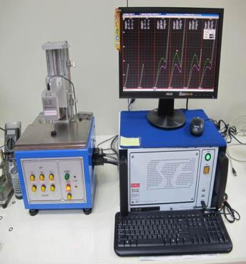
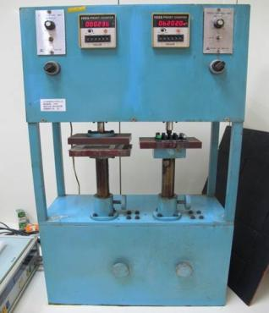
Inspection Instrument:
Desktop Force Tester (Switch feeling tester)
Fatigue Testing Machine
RCA Abrasion Wear Tester

Slide 24
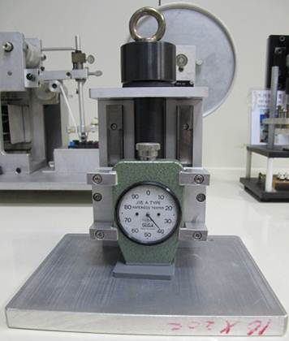
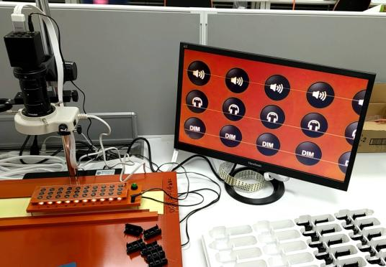
Inspection Instrument:
High Magnification Inspection
Hardness tester (1Kg)

Slide 25
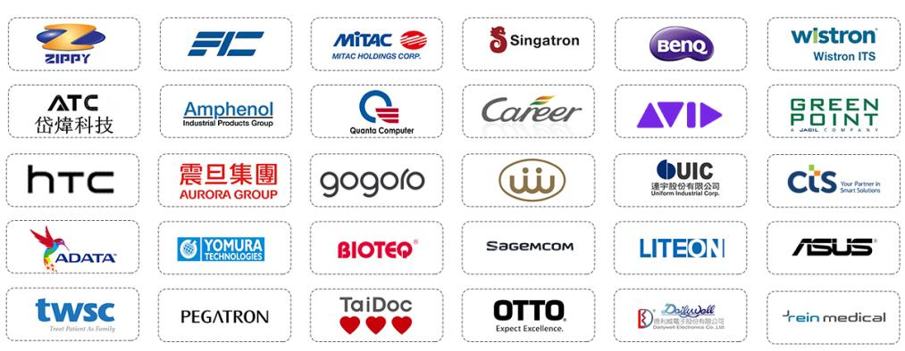
Our customers:

Slide 26
Our Company Official Website :
https://www.en.chieftechrubber.com/
Contact Vera through <sales1@chieftechrubber.com>, or +886 919707296 for further discussion.

